Slide 1
Computer Modeling and Simulation
By
Sara Rehmat
MS(CS)

Slide 2
Model and Simulation
Model is a static representation of a particular world.
Simulation adds a temporal aspect to a model by depicting how the system being modeled changes over time. So simulation can be deﬁned as a time – varying representation of a model.
One may also think of simulation as a process by which you perform experiments on a model to see how a real system would behave if it had the same experiments performed on it.

Slide 3
Types of Simulation
Continuous Simulation
Discrete-Event Simulation

Slide 4
Types of Simulation
Discrete event simulation relies on the occurrence of speciﬁc events to advance a model from one state to another over time.
Continuous simulation represents model behavior over a continuum of time independent of events occurring in the system.

Slide 5
Concepts in DES
Discrete Event Simulation is the variation in a model caused by a chronological sequence of events acting on it.
Events are instantaneous occurrences that may cause variations or changes in the state of a system.
The state of a system is defined as one or more variables that completely describe a system at any given moment in time. These variables are called state variables.

Slide 6
States and Events
Take the example of traffic light.
State: Its state can be represented by which light is activated at any given time. So State variable called light color is chosen to represent its state. The value of that variable at any given point in time completely describes the state of the traffic light.
Events for the traffic light system consist of switch to red, switch to yellow , and switch to green . These events occur in a predetermined sequence and may be triggered by the passage of a certain amount of time. Or they may be triggered by the event of the presence of a vehicle over some roadway sensor or a video system recognizing when a vehicle enters its field of view.

Slide 7
Simulation Clock
Another component of a discrete event simulation system is a clock.
The clock keeps track of simulation time and may be used to trigger events in the system such as when to switch colors from red to green.
Simulation time may or may not be the same as wall clock or real time.
Wall clock time refers to how humans perceive the passage of time.
A simulation may run at wall clock time to provide a realistic representation as perceived by a human. It may also run considerably faster than wall clock time to allow for analysis of a system that would normally take hours, weeks, or months to evolve in real time.
The ability to study the behavior of a system in a compressed amount of time is one advantage of using simulation.

Slide 8
Simulation Clock
A discrete event simulation program does not simulate in real time. The program only simulates what goes on at those discrete instants when an event occurs.
Once the program has processed an event, the program does an instantaneous time warp to the time of the next event, and processes that.
The program repeats this until it runs out of events. In this way, the passage of minutes, hours, or days of simulated time can take place in microseconds of program execution time.

Slide 9
Discrete Event Simulation
The program simulates a series of events that happen at discrete instants, it is called a discrete event simulation program.
As another example, consider a web server.
The HTTP request messages from users’ web browsers arrive at the server and go into a queue.
The server takes the first request in the queue, looks up the necessary information in its database, formulates an HTTP response message containing the requested web page, sends the response back to the browser, and goes on to the next request in the queue.

Slide 10
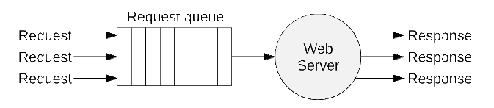
A simplified Web Server

Slide 11
We want the web server simulation program to produce output like this:

Slide 12
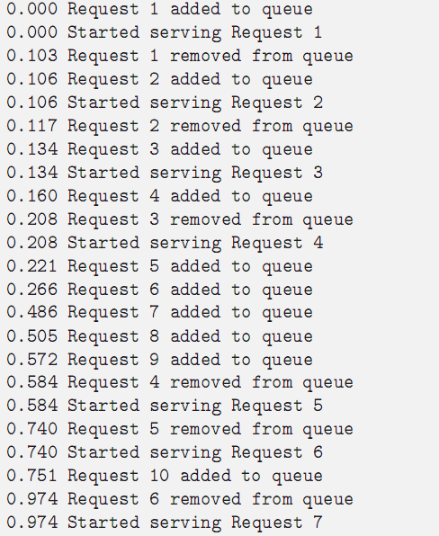

Slide 13
DES of a Web Server
The events consist of adding a request to the queue, starting to serve the first request in the queue, and removing a request from the queue (when ﬁnished serving it).
Each event happens at a particular instant in time, listed at the beginning of each line.
The unit of time doesn’t matter, as long as we use the same unit throughout the simulation.
The program simulates the events in ascending order of time.
Along with the simulation of events, the time is also being simulated.

Slide 14
Probability in DES
The inter-arrival time is the difference between the times when successive requests arrive at the queue. In this example, the interarrival times are 0.106, 0.028, 0.026, 0.061, 0.045, 0.220, 0.019, 0.067, 0.179.
We will model the inter-arrival time as a random variable with a certain probability distribution, based on what we know (or assume) are the characteristics of the users and web browsers sending the requests.
So to write the web server simulation program, we will need to generate random numbers obeying this distribution, whatever it might be.
After arriving at the queue and possibly sitting there a while, the server begins serving the request, and sometime later finishes serving the request and removes it from the queue.

Slide 15
The service time is the diﬀerence between the times when the server starts and ﬁnishes serving a request.
In this example, the service times are 0.103, 0.011, 0.074, 0.376, 0.156, 0.234, 0.093, 0.020, 0.010, 0.004.
Like the interarrival time, we will model the service time as a random variable with a certain probability distribution, based on what we know (or assume) are the characteristics of the web server, and we will need to generate random numbers obeying this distribution.

Slide 16
Events in DES of Web Server
Events can trigger the creation of other, future events. Adding a request to the queue also triggers the future event of adding the next request to the queue, after the proper random inter-arrival time has elapsed (provided there are more requests to simulate). When a request comes to the front of the queue and the server starts serving it, that also triggers the future event of removing the request from the queue, after the proper random service time has elapsed.
However, the times of the arrival, start-serving, and removal events for a particular request are completely independent of the event times for the other requests. Events related to one request could be interleaved arbitrarily with events related to other requests. T
The discrete event simulation program must somehow contrive to keep track of all these events and process them in ascending order of time.

Slide 17
Queuing System – A DES
This type of system is known as a queuing system and it is representative of many types of systems found in our daily lives.
A queueing system occurs any time 'customers′ demand 'service′ from some facility; usually both the arrival of the customers and the service times are assumed to be random.

Slide 18
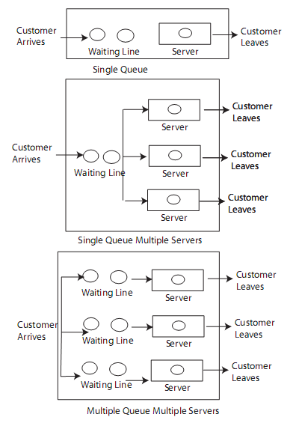
Different Configurations of Queuing Model

